Slide 1

Netflix Movie
Recommendation
Presented by: GROUP 4
Maryam Merchant - Team Leader
Sai Teja Karlapudi - Data Scientist
Sai Saketh Kambalapally - Data Modeling
Bhuvaneswari Vallagachu - Storytelling and data visualization

Slide 2
Netflix Users
Netflix allows us to watch variety of TV shows, movies in different languages and genres on subscription based. Our main customer is users and based on statistics Netflix customers spend 3.2 hours each day on average consuming content
2022
220.67M
Subscribers Count: 220.67M
219.7M
2021
192.9M
Subscribers Count: 219.7M
2020
Subscribers Count: 192.9M

Slide 3
The Main Problem Arises when it’s time to watch some shows on Netflix
.
What to watch?
Problem Frustrating when we are not able to find something interesting to watch.
01

Slide 4
The Solution
Knowing the importance of recommendations on the entertainment industry, we are planning to replicate and also try to improve the ability of the recommendation algorithms. To provide movie recommendations, we have selected the Netflix which is one of the prominent platforms of OTT.
The main objective of the project is to analyze and understand the insights from Netflix and suggest shows based on user preference.
To predict 100000 movie ratings for users in a subset of original Netflix data
To substantially improve the accuracy of predictions about how much someone is going to enjoy the movie based on their movie preferences.
01
02
03

Slide 5
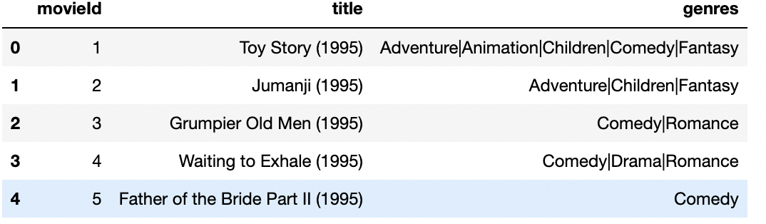
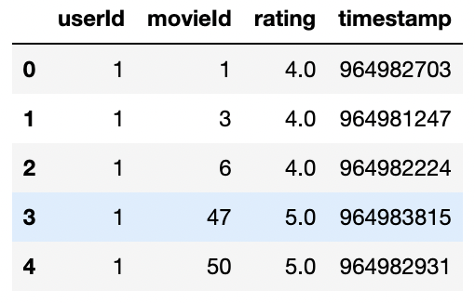
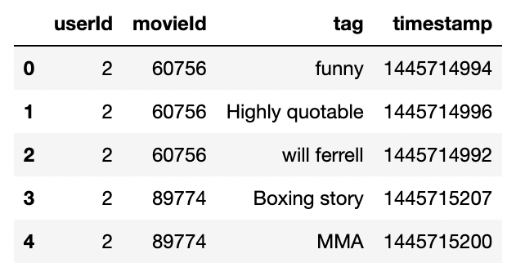
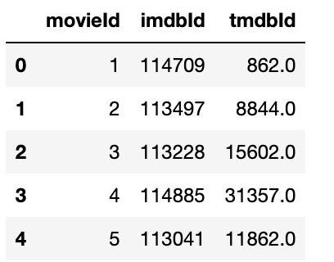
Netflix Dataset from Kaggle
Our dataset has 4 different tables which are:
1. Movies table
2. Ratings table
3. Tags Table
4. Links Table
Movies Table:
Ratings Table:
Tags Table
Links Table

Slide 6
Business model / Plan
Dataset
Dataset from Kaggle
Deployment
Data Understanding
Resulting the output to recommend the top rated shows to users
Understanding different tables and it’s uses
Our Plan
Evaluation
Data Preparation
Evaluating the result by using different machine learning algorithms
Eliminating missing values
Modeling
Modeling using Matplotlib, Plotly libarary

Slide 7
Technologies we will use
Python libraries: Numpy, Pandas, Matplotlib, Plotly, Schikit-learn
Machine Learning Algorithms
Cloud Computing
PySpark
1
2
3
4

Slide 8
Summary
Providing customers with recommendations has become a core part of the digital entertainment industry.
1
Based on movie ratings, tags, genres and titles we will provide the top-rated shows to customers.
Suggesting shows based on user preference.
Let people spend cherish able time watching the movie.
2
3
GitHub Account:
https://github.com/Distributed-and-scalable/Netflix-Recommendation-System

Slide 9
THANK YOU

